Slide 1
Extended Error Messages
Error Messages are limited in the number of characters that can be displayed,
They are nonproprietary in nature
Therefore the content of the information contained is minimal.
The Extended Messages contain very valuable information for GE Field Engineers to help troubleshoot root cause, potential FRU information, etc!

Slide 2
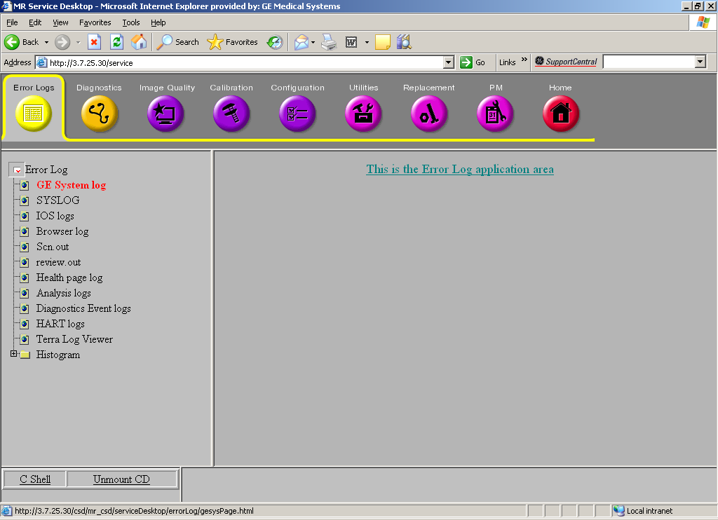
GE FEs should ALWAYS access the Error Log via this method to ensure they have access to Important Extended Error Information!
1. Click on [Error Logs]
2. Click on
[GE System Log]

Slide 3
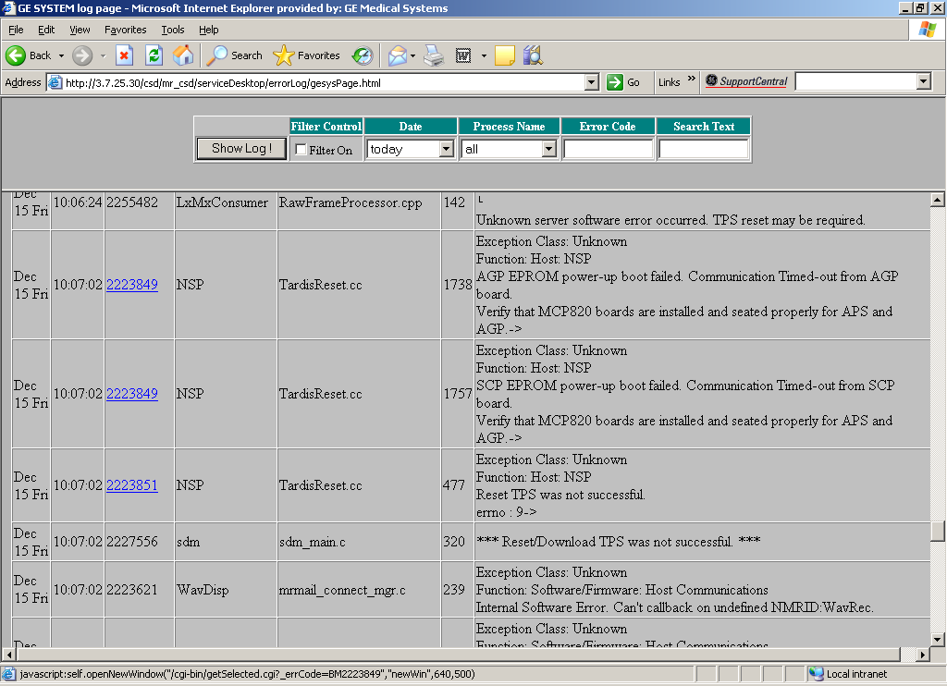
3. Error Log Window Opens. Scroll to find message of interest

Slide 4
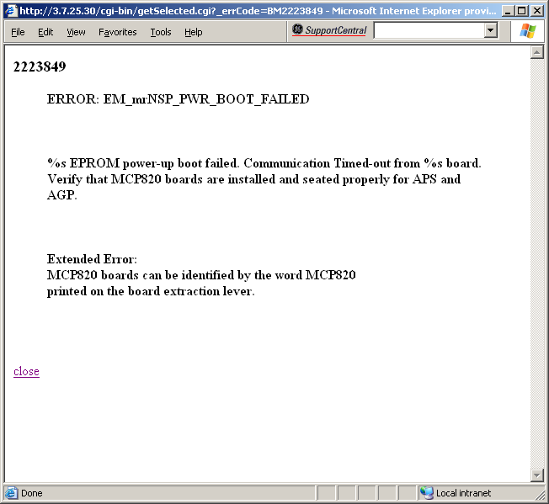
5. Message window will open containing information that will help troubleshoot root cause
4. Any Error Message Number that is blue and underlined has a LINK to an EXTENDED ERROR MESSAGE. Click on Error Number

Slide 5
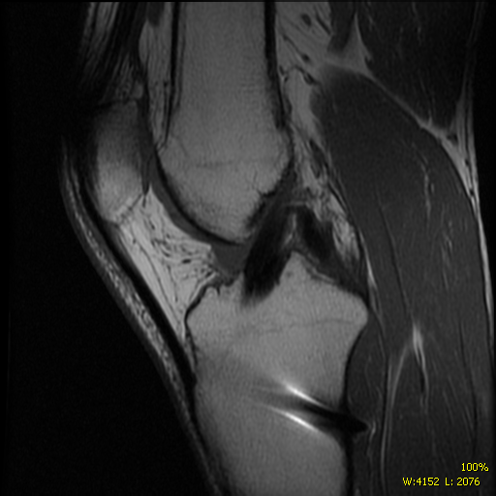
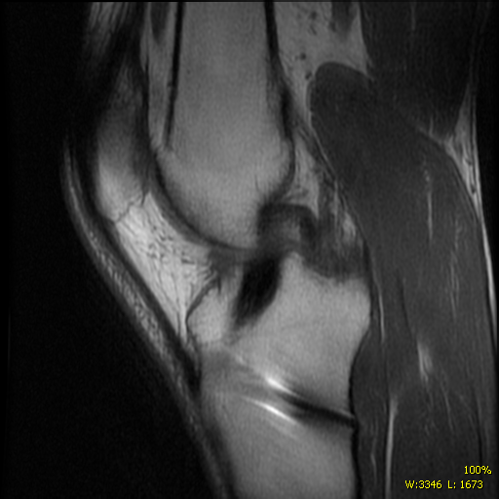
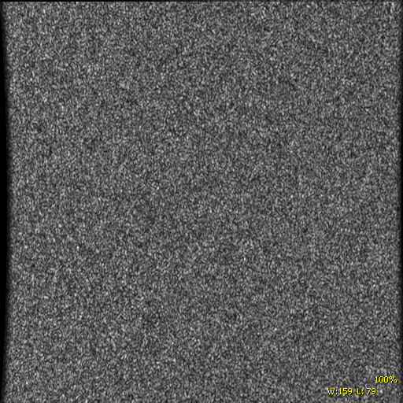
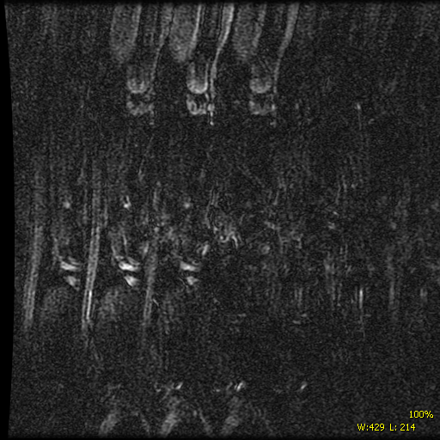
Case in point: Kaiser San Rafael
Blurry, noisy images.
3 acquisition scan shows 1st acquisition good, 2nd a little blurry, 3rd has complete loss of signal.
Another series on same exam, completely destroyed.

Slide 6
The only diags that fail are the SRF->IRF Data Path. Errors: 2253619 and 2253618
Jul 29 Tue
18:18:11
2253619
diagCoord
srfToIrf.c
351
Diagnostic: SRF->IRF DP Iteration: 1 of 1 Action: 1
Task ID: 0x7f53f40 Time: 11852 Object: APS Test Task
Function: Software/Firmware/Config: N/A
SRF->IRF Datapath test detected a checksum error on the sequence bus.
Data on this bus is being corrupted by one of the devices hooked to the bus.->
Jul 29 Tue
18:18:11
2253618
diagCoord
srfToIrf.c
406
Diagnostic: SRF->IRF DP Iteration: 1 of 1 Action: 1
Task ID: 0x7f53f40 Time: 11857 Object: APS Test Task
Function: Software/Firmware/Config: N/A
SRF->IRF Datapath test detected bad data.
First bad value 0x00100000, Expected 0x00000000->

Slide 7
Extended Errors: (Notice the text in red)
2253619
ERROR: EM_DIAG_SRF_IRF_SEQ_CHKSUM_BAD
SRF->IRF Datapath test detected a checksum error on the sequence bus.
Data on this bus is being corrupted by one of the devices hooked to the bus.
Extended Error:
During this test, data was sent by the SRF to the 32-bit sequence bus on
the MDG backplane, past the STIF board, and into the IRF board. The IRF detected
that the data was corrupt. This might be caused by a bad board or a bad
backplane. You can isolate the effect of the STIF board by removing that board
(power down first) and running the SRF-IRF diag again.
The system will not run without the STIF board but the SRF-IRF diag can be run.
If the test passes without the STIF the STIF is defective.
Otherwise, the problem is in the SRF, IRF, or backplane.
Check for bent packplane pins. Re-seating the IRF/SRF/STIF might help.
Possible cause(s): SRF Board, IRF Board, STIF Board, MGD Backplane
-----------------------------------------------------------------------------------
2253618
ERROR: EM_DIAG_SRF_IRF_BAD_DATA
SRF->IRF Datapath test detected bad data.
First bad value 0x%08X, Expected 0x%08X
Extended Error:
This test verifies that the SRF can send data to the IRF over the
sequence bus on the MGD backplane. This bus connects the SRF, IRF, and
STIF boards. This test will fail if the SRF can not send a 32-bit parallel
signal to the IRF. The STIF is not tested by this diag but a fault on the
STIF can also make this diag fail.
Possible cause(s): SRF Board, IRF Board, STIF Board, MGD Backplane

